Slide 1
UK Bank Customers Dashboard
File created on: 8/10/2023 9:19:33 PM

Slide 2
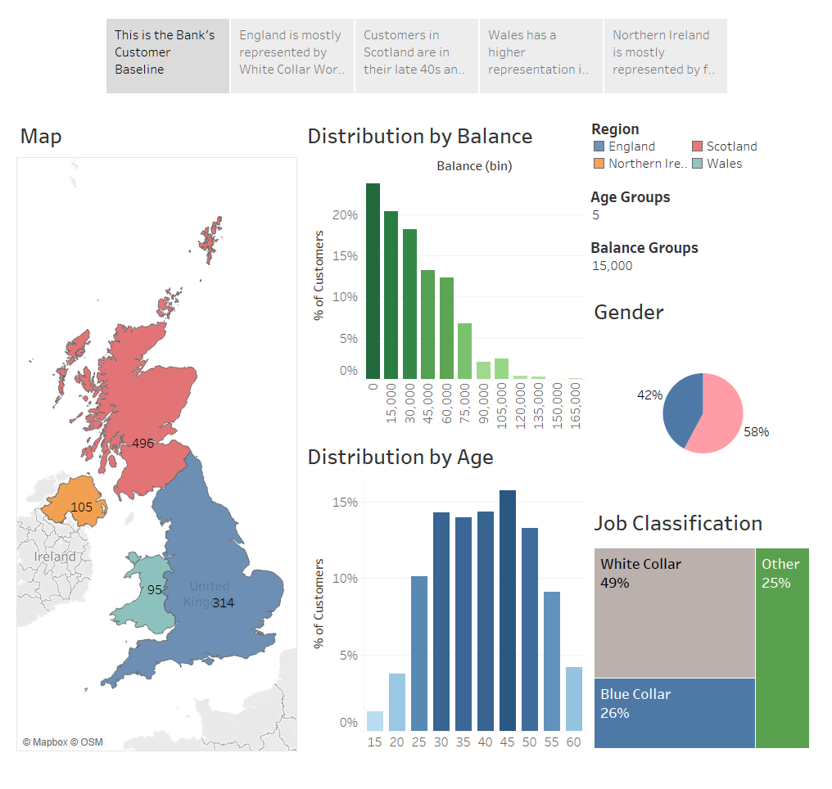

Slide 3
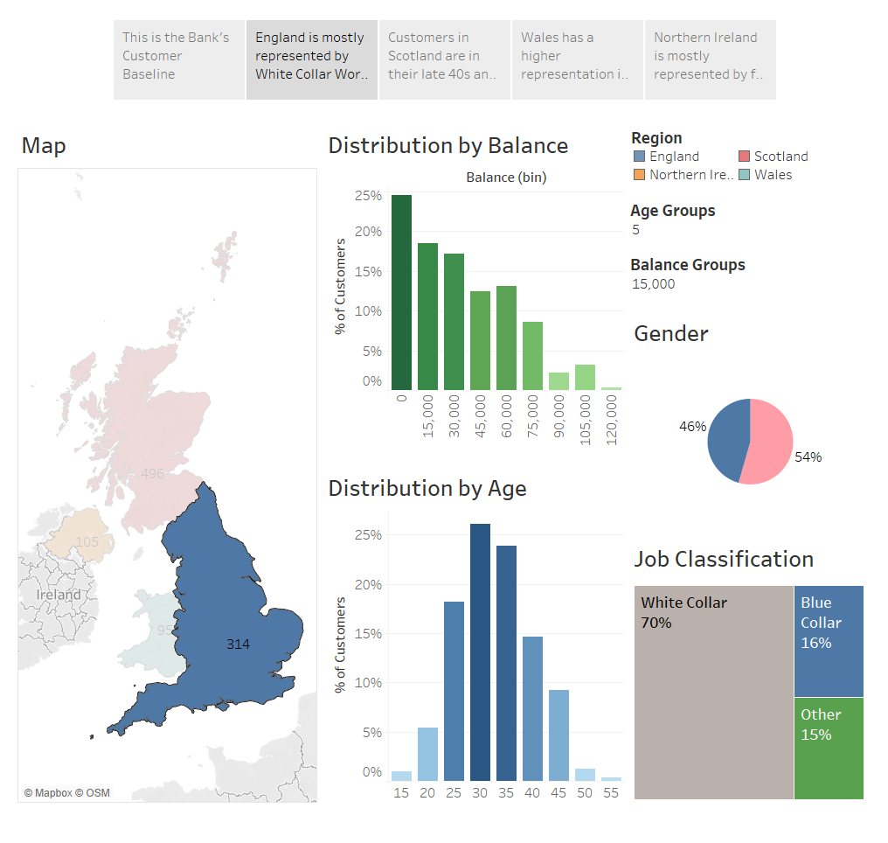

Slide 4
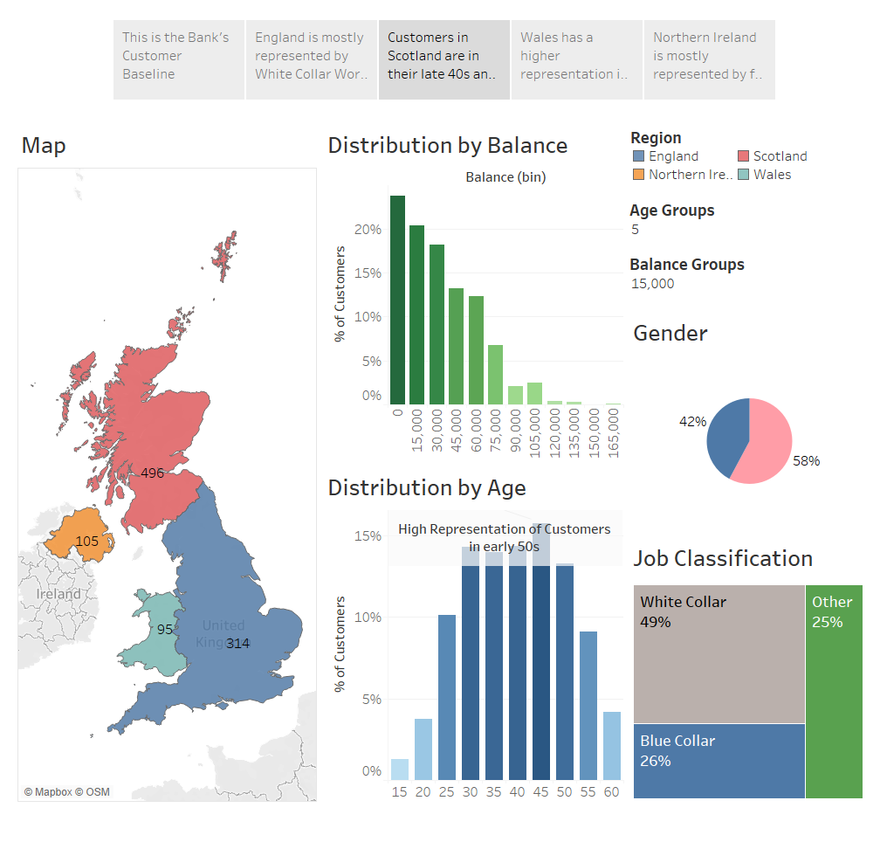

Slide 5
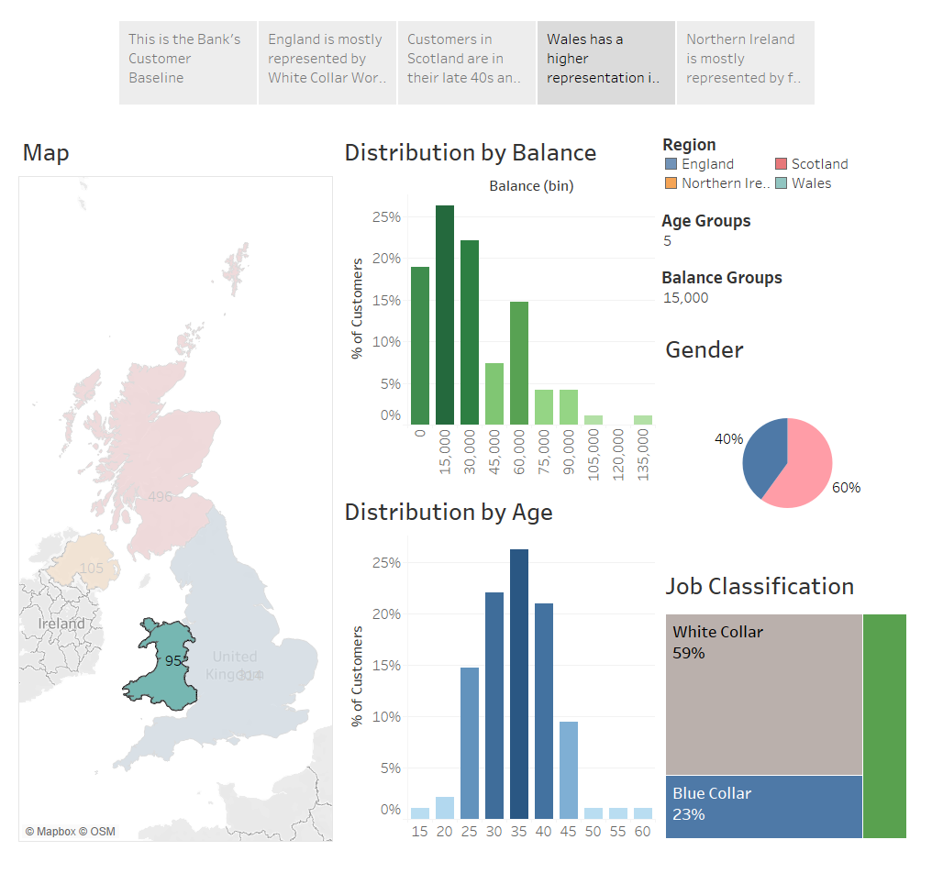

Slide 6
